Slide 1
8 – Clean Code – SOLID Introduction
Based on the CleanCoders videos by Uncle Bob Martin
Rupert Waldron

Slide 2
Design vs Build - Hardware
The source code is the design… the product is the running program. The compiler is the factory that builds the design and creates the product.
Designing a circuit board is much cheaper than building it
Architecting a building is much cheaper than building it
In both cases the cost of correcting errors after completion is enormous.
So a great deal of time is spent upfront on design to minimize the cost of building

Slide 3
Design vs Build - Software
With software the reverse is true, the cost of building and fixing errors is low by comparison.
Where as the cost of design is high, those software developers don’t work for free (apart from opensource)
This inversion of cost means the strategy for building software is entirely different from that of building a house.
What if it cost $100 and 1hr to build a house, and every change to that house cost $100 and took 1hr – how would you go about building that house?
Would you hire an expensive architect to spend months designing the house?
OR
Would you build the house quickly, look at it, list the changes you need and then build it again?

Slide 4
Iterative evolution
The software most be designed in a way that allows continuous change – TDD, Cleaning the code
In order to clean those designs we must recognize when designs are going bad.

Slide 5
Design Smells - Rigidity
Rigidity is when a system is hard to change.
when cost of change is high. E.g. if a build and test takes 3hrs for a tiny change.
Long running tests is an indication the developers have been careless.
There also a symptom of high coupling when small changes require an entire rebuild.
The design goal should be if you change one module the other modules should remain unaffected

Slide 6
Design Smells - Fragility
Fragility is when a small change to one module causes other modules to mis-behave.
This is caused by coupling and dependencies.
Fragility is viewed by managers and customers as an indication of engineering incompetence.
Solution to manage dependencies between modules and isolate them from each other.

Slide 7
Design Smells - Immobility
A module is immobile if it’s modules and units can’t easily be moved to another application or environment.
Caused by couplings and dependencies
Solution is to decouple the application.

Slide 8
Design Smells - Viscosity
When necessary operations like build, merge and test take a long time. Caused by tight coupling.
Cure is to decoupling modules and manging the dependencies that remain.

Slide 9
Design Smells – Needless Complexity
Should we design our software for today’s requirements or change the design based on predicted future requirements?
Systems that carry a lot of anticipatory design are needlessly complex because there is a lot of additional features that mean you wont have to change the design too much later
However, if you follow the advice from episode 6 (TDD) and maintain a comprehensive set of tests, you wont be afraid to change the code
Your designs will be simpler and easier to maintain
The more future relationships between software we anticipate the more coupled the software becomes now.
Keep you design focused on the current requirements and maintain a comprehensive set of tests

Slide 10
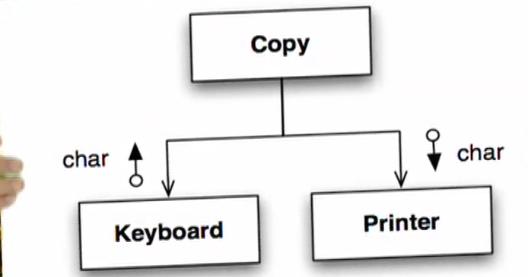
Lets see how code rots – version 1
Write some code to copy characters from the keyboard to the printer…
Copy contains the high level policy – loop until char == EOF

Slide 11
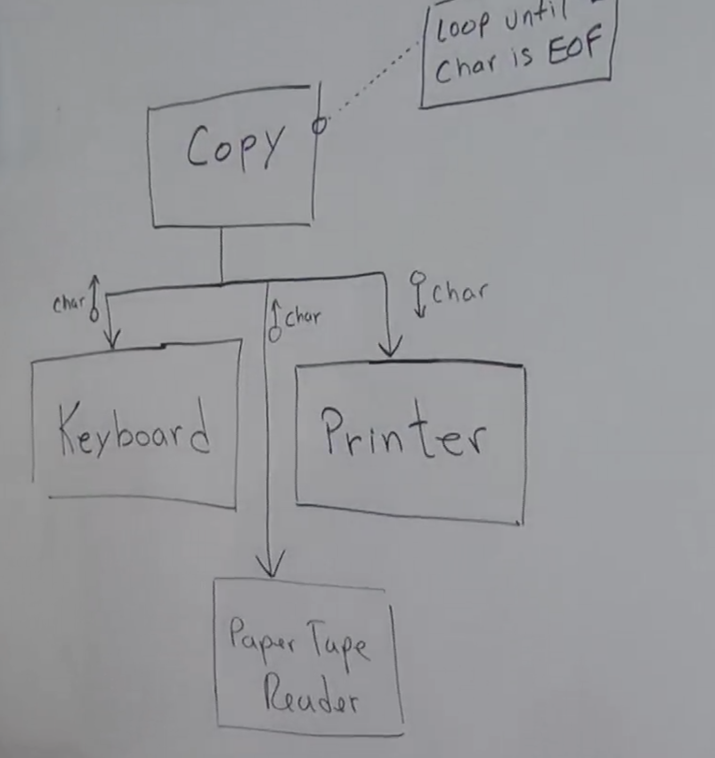
Add some more requirements – read from paper tape reader – version 2
Some sort of if / else?? Go posh with a Ternary operator

Slide 12
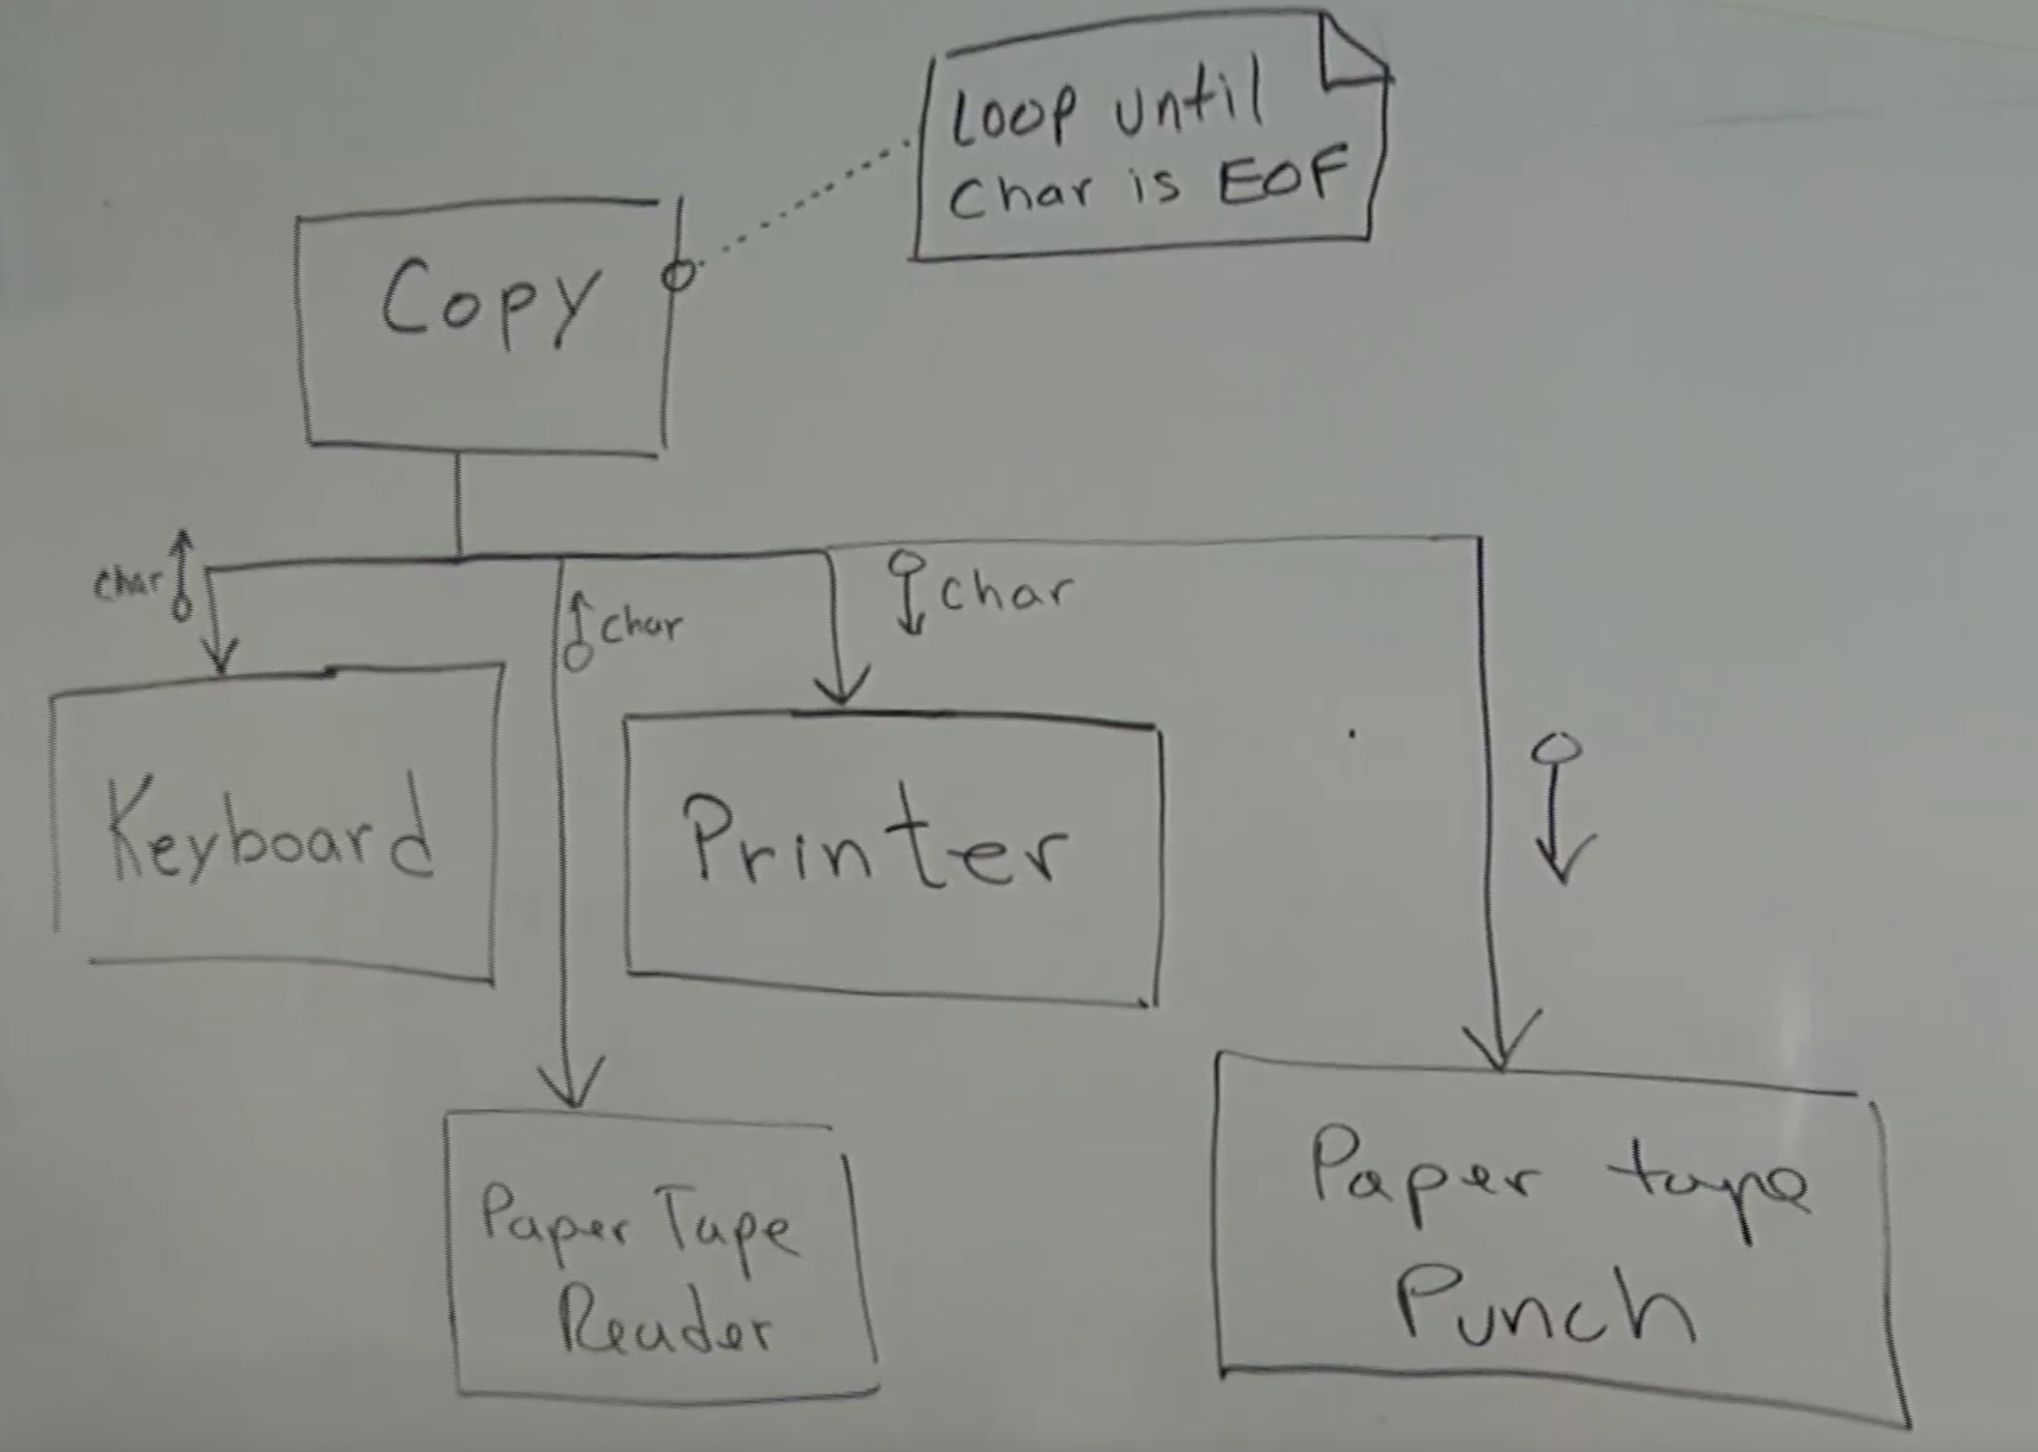
Add some more requirements – write to papertap punch – version 3
Another if/else?
This code is rotting…

Slide 13
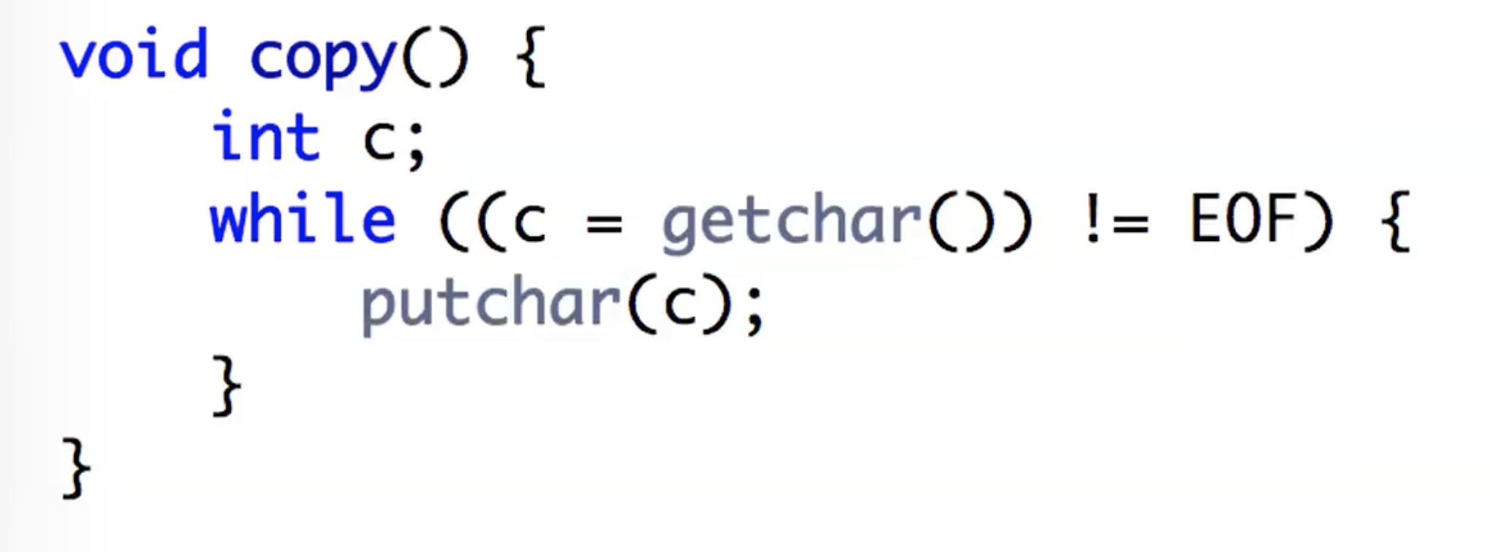
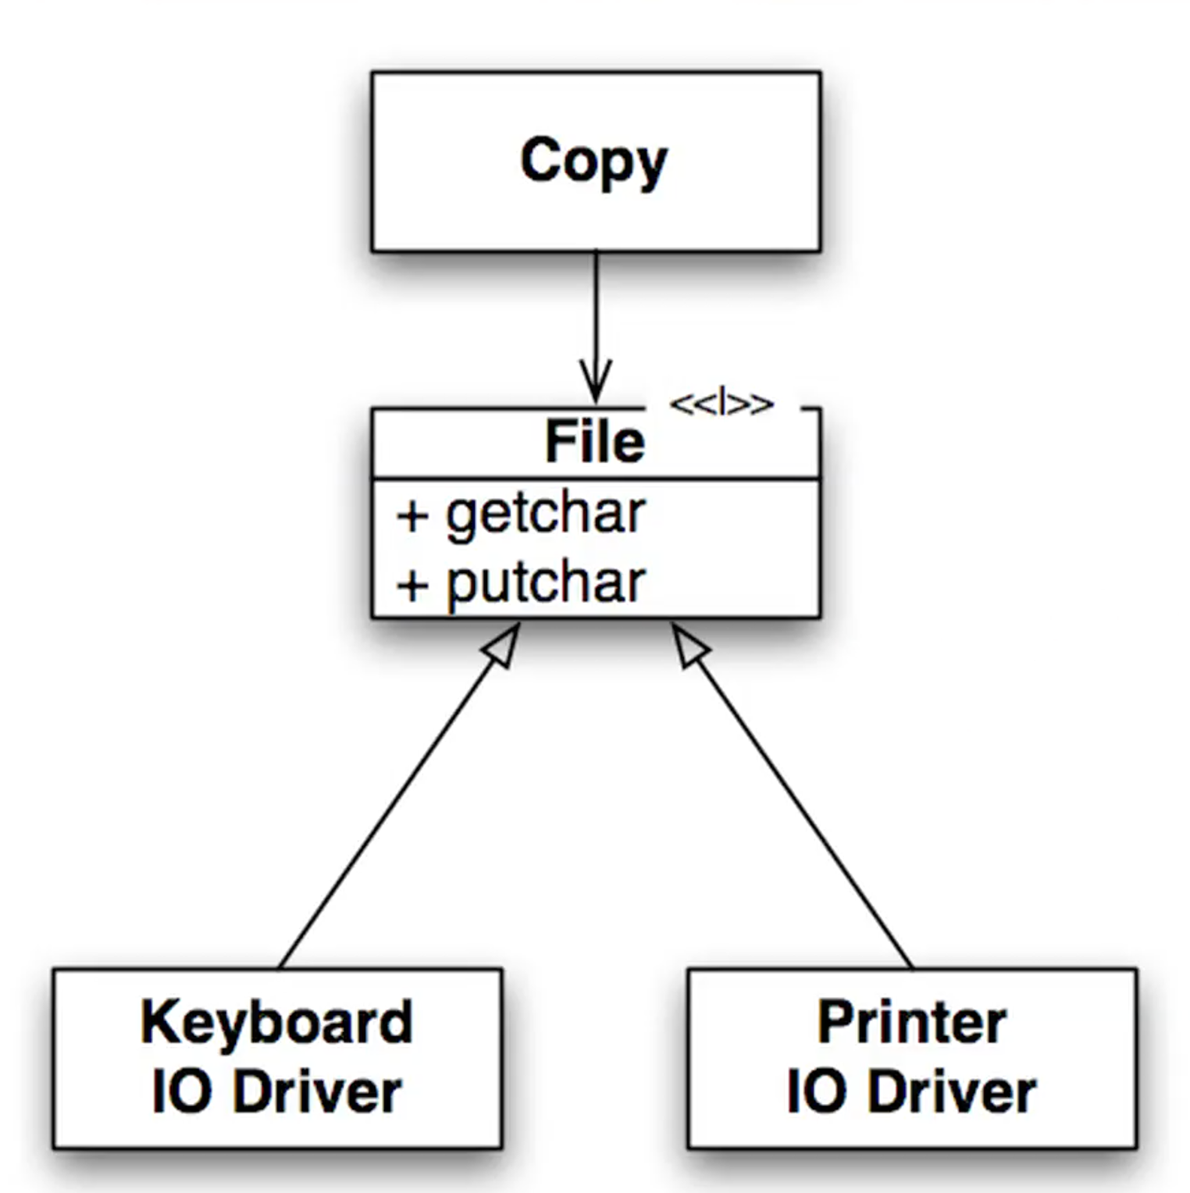
How to do it properly
Flow of control
Look at the direction of the arrows, the module containing the high level policy depends on low-level detail.
Showing the inversion of dependencies – can change what the copy program does but don’t have to change to copy program. Polymorphism in action. Note the inversion of dependencies.
Flow of control

Slide 14
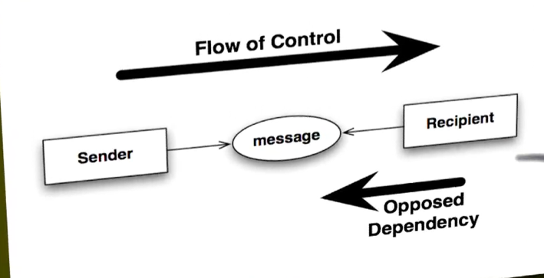
Small talk – Alan Kay’s version of OO
The essence of oo… the message is the abstraction. High level policy no long depends on low level details.

Slide 15
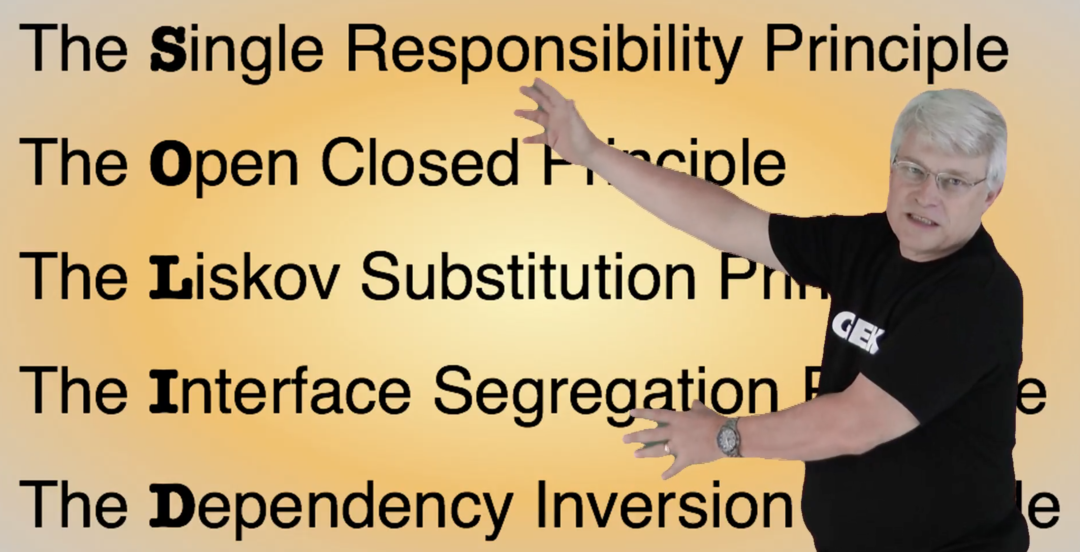
Object Orientated Design is all about Dependency Management
Uncle Bob gives us these dependency management principles that control operations and relationships between classes

